Slide 1
INF700 IT for Business and Management

Slide 2
Plan for Today
Part 1- Ice breaker + Introduction to BIS (30 mins)
Part 2 – Data, Information and knowledge (1 hour, 20 mins)
Short Break (10 mins)
Part 3 – IT, Strategy and competitiveness (1 hour)
Levels of Strategy
Developing Strategy

Slide 3
- Your Name - Affiliation - Major/Programme, Year - Which themes (IT/Business) excite you the most? - What are your expectations at the end of this course?

Slide 4
Brief Profile and Introduction
Andrew Adjah Sai, CIMA Adv. Dip. MA
Education
Work Experience
PhD (Management Science) candidate
Chartered Institute of Management Accountants (UK)
*CIMA Advanced Diploma in Management Accounting
Masters (Information Systems Management)
Bachelors (Human Resources Management)
Certification: A+[Windows]; N+[Networks and Configurations]
Visiting Lecturer, IT for Business & Mgt, EBS
Lecturer/Module Lead [EBS MBA in Digital Society program]- Tallinn & Helsinki
Visiting Lecturer [TUT(TalTech), Euro academy, Mainor]
Product Operations Analyst, Twilio
Operations Analyst, Microsoft
Senior Auditor, National Audit Office of Ghana
Project Manager, FedEx
Project Coordinator, AGRIBIZ Ghana
Junior Internal Auditor, PMMC Ghana
Research Interests: information technology; technological change; macroeconomic policy and strategy; ecommerce, organizational performance, institutional development, strategic management, change management and business process architecture, business and information systems management, finance and accounting, human resource management and so forth.
www.andrewsai.com

Slide 5
Course Overview

Slide 6

Module 1 Data, Information and Knowledge
Module 2 Information Systems & Enterprise Strategy
Module 3 IS Infrastructure
Module 4 Business Process Management
Module 5 Information Systems Security

Slide 7
Syllabus

Slide 8
Objectives of the Course
Understand how effective IT strategies are aligned to overall business strategy
Understand how IT will shape future businesses and be prepared to contribute to enterprise architecture decisions, infrastructure strategies, business application needs, IT investments and prioritization to increase business value
Understand the risks and benefits of IT investments and whether to outsource or use internally generated approaches
Understand how to lead the firm in the appropriate use of IT to achieve enterprise strategy as general managers

Slide 9
Intended Learning Outcomes
A broad knowledge of innovation frameworks to analyze competitive landscapes for emerging IT products and services
Ability to compare IT governance models in single and multiple contexts
Ability to analyze disruptive potential of technology, assess its transformative impact on standard business practices and formulate appropriate responses for an organization
Proficiency to create a business case for the value of an IT initiative or investment
Ability to identify the components of enterprise information architecture and its strategic role in the organization
Ability to use appropriate tools to analyze datasets, produce results and interpret same.

Slide 10
Modules Assignments

Slide 11


What is Technology? What is Information Technology? What is Business and Management?

Slide 12
IT - “is the use of computers to store, retrieve, transmit, and manipulate data, or information, often in the context of a business or other enterprise” Business - “any activity or enterprise entered into for profit.” Management - ”the process of dealing with or controlling things or people.”

Slide 13
Module 1 Data, information & Knowledge

Slide 14
Introduction to BIS

Slide 15
PRIMARY CONSTITUENTS OF BIS
What is data?
What is information?
What is a system?
What is a Business Information System?

Slide 16
What is BIS?
Data are raw facts or observations that are considered to have little or no value until they have been processed and transformed
e.g., today’s date, measurements taken on a production line, a record of a business transaction, such as a visit to a website

Slide 17
Transforming Data into Information using a data process (data process is any action used to place data into a meaningful context)
Data
Transformation process
Information
Classification: - placing data into categories, e.g., - fixed or variable costs
Re-arranging/Sorting: - Organising data so that items are grouped/placed into particular order
Aggregating: - Involves summarizing data, e.g., calculating averages, totals, sub-totals, etc.
Performing Calculations: - E.g. Calculating employee gross pay by multiplying number of hours worked by hourly rate of pay, etc.
Selection: - Choosing/Discarding items of data based on a set of selection criteria, e.g., sales organization creates a list of potential customers according to income levels.

Slide 18
Information
Information is data that has been:
- Processed so that they are meaningful
- Processed For a purpose
- Interpreted and understood by the recipient
e.g., a bank statement, a sales forecast, a telephone directory, graphs of trends in visitor numbers to a website

Slide 19
Knowledge Check!
Data v Information
1. The date
2. A bank statement
3. The number 1355.76
4. A National Insurance Number (Isikood)
5. A Balance Sheet
6. A bus timetable
7. A car registration plate

Slide 20
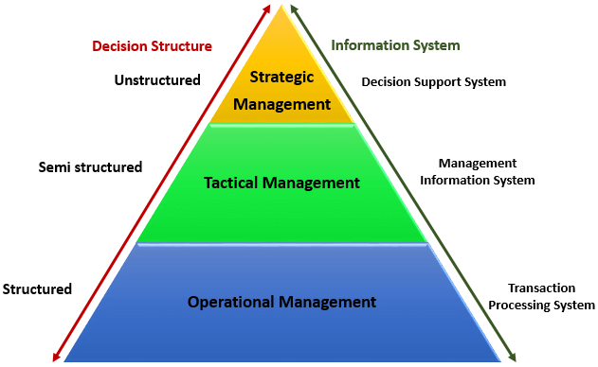
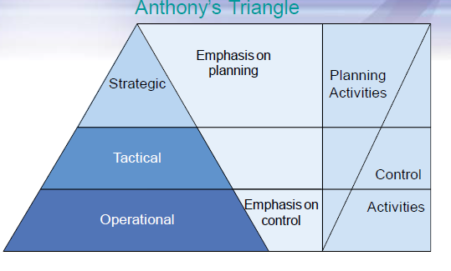
Levels of Management: Decisions –making
Management level | Type of decision | Time Scale | Impact on Organisation | Frequency of decisions
Strategic | Unstructured | Long | Large | Infrequent
Tactical | ↔ | Medium | Medium | ↔
Operational | Structured | Short | Small | Frequent
10/03/2019
www.andrewsai.com

Slide 21
Levels of Management: Information Needs
Management level | Time period | Frequency | Source | Certainty | Scope | Detail
Strategic | Wide | Infrequent | External | Less certain | Wide | Summarized
Tactical | ↔ | ↔ | ↔ | ↔ | ↔ | ↔
Operational | Narrow | Frequent | Internal | More certain | Narrow | Detailed

Slide 22
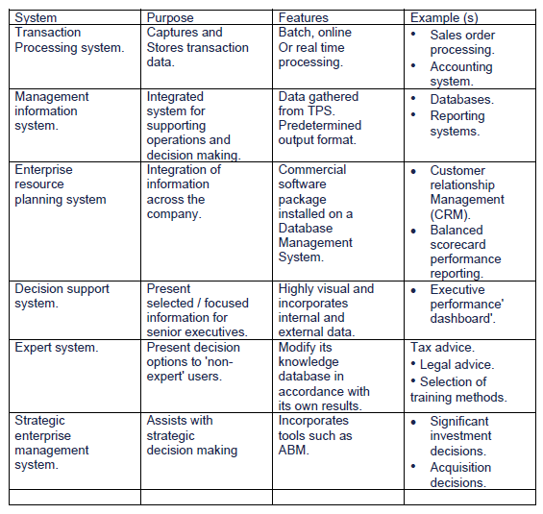
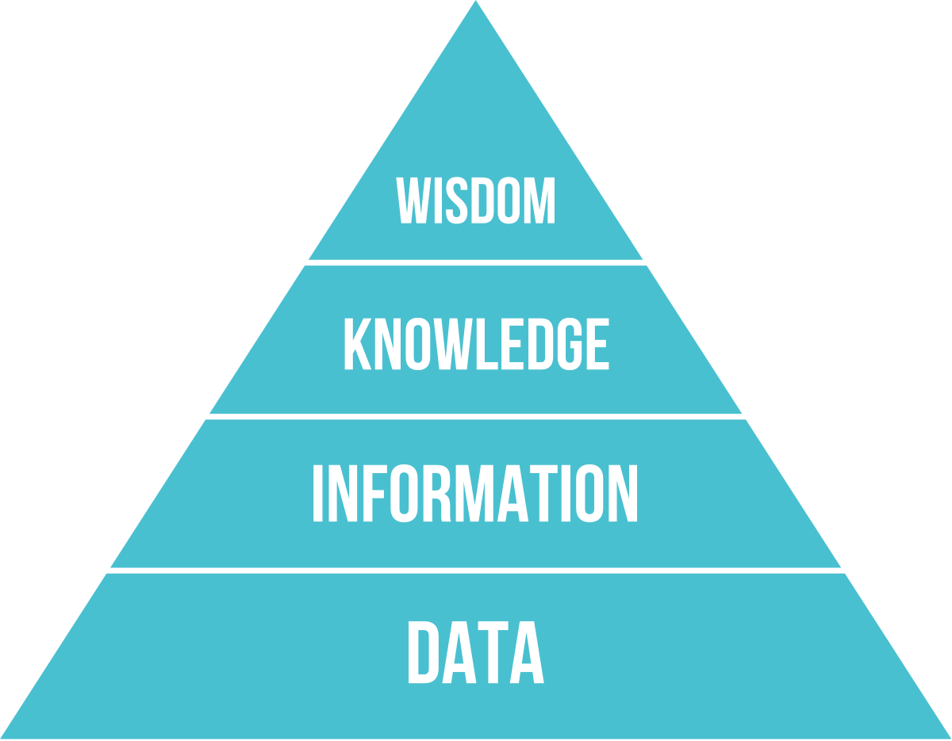
Levels of Management, Decisions–making & Information Needs [Examples]

Slide 23

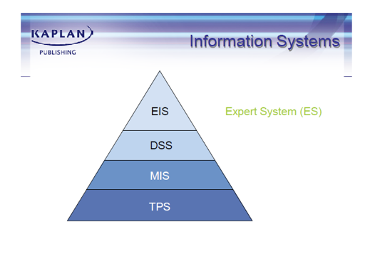



Information Systems Pyramid

Slide 24
Transaction Processing System
This is the system that records historic information and it represents the simple automation of manual systems
The TPS routinely captures, processes, stores and outputs low level transaction data.
This system is very important. Data input incorrectly will affect every report produced using it, giving management misinformation and hence will make poor decisions

Slide 25
Management Information System
A management information system is defined as ‘ a system to convert data from internal and external sources into information, and to communicate that information in an appropriate form to all managers at all levels and in all areas of the business to enable them to make timely and effective decisions’

Slide 26
Enterprise Resource Planning System (ERPS)
An enterprise resource planning system is comprised of a commercial software package that promises the seamless integration of all the information flowing through the company – financial, accounting, human resources, supply chain and customer information.
This is achieved by holding the data for all transaction and management information system on a common database.

Slide 27
Decision Support System (DSS)
A decision support system is defined as a ‘computer-based system which enables managers to confront ill-structured problems by direct interaction with data and problem solving programs.’
They are computer systems which are used as an aid in making decisions when presented with semi-structured or unstructured problems.
Their aim is to provide information in a flexible way to aid decision making.

Slide 28
Executive Information[Support] System (EIS)/[ESS]
An executive support system (ESS) or executive information system (EIS) is an interactive system that allows executives to access information for monitoring the operations of the organisation and scanning general business conditions.
It gives executives ready access to key internal and external data.

Slide 29
Expert Systems (ES)
An expert system is defined as a ‘computerised system that performs the role of an expert or carries out a task that requires expertise’
The system holds expert/specialist knowledge and allows non-experts to interrogate a computer for information, advice and recommended decisions.

Slide 30
Strategic Enterprise Management Systems (SEMS)
A strategic enterprise management system assists management in making high-level strategic decisions
Tools such as activity-based management (ABM) and the balanced scorecard are applied to the data to enable the strategic goals of the organisation to be worked towards.

Slide 31
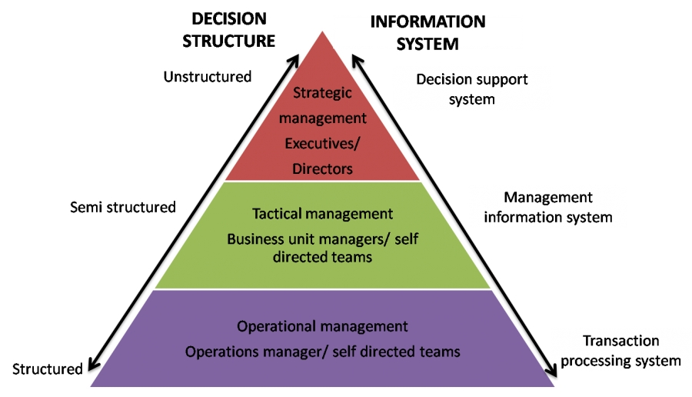
Organisation-level decisions (Quick Exercise)
Classify the following:
by type (Structured, semi-structured, unstructured) and
organisational level (strategic, tactical, operational).
In addition, determine whether or not the decision-making process should be automated, and if possible,
the name and type of information system to be used.
At what level should we set the budget for next year?
Does this customer qualify for a discount on a large order?
How should we deal with a takeover bid?
Should we employ more staff to cope with an urgent order?
Should we expand abroad?
Should we launch an advertising campaign?
Should we take a short-term loan to help our current cash flow position?
What new markets should we move into?
What should we do about a faulty machine?

Slide 32
Knowledge & KM
What is Knowledge?
Knowledge – applying managerial experience to problem solving
Knowledge Management (KM) – Techniques and tools for collecting, managing and disseminating knowledge within an organisation
Types of knowledge?
Explicit – knowledge that can be readily expressed and recorded within Information Systems
Tacit– Mainly intangible knowledge that is typically intuitive and not recorded since it is part of the human mind.

Slide 33
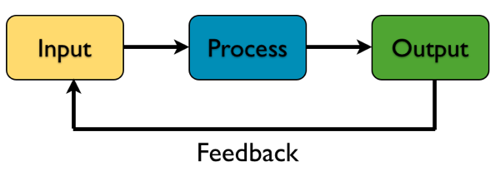
A System
A collection of interrelated components that work together towards a collective goal.

Slide 34
Characteristics of Systems?
1. Environment – the surroundings of a system, beyond its boundary
2. Boundary – the interface between a system and its environment
3. Interface – defines exchanges between a system and its environment, or other system
4. Sub-system – one or more smaller systems in a larger system
5. Supra-system – a large system made up f one or more smaller systems (subsystems)
6. Open System – interaction occurs with elements outside the system boundary
7. Closed system – No or limited interaction occurs with the environment

Slide 35
Generic model of a system

Slide 36
Modules of a standard accounting system, plus additional purchasing, sales order processing and payroll modules Source: Bocij, Chaffey, et al.

Slide 37
A Human Resource Management system

Slide 38
What is a Business Information System (BIS)?
Group of interrelated components that work collectively to carry out input, processing, output, storage and control actions in order to convert data into information products that can be used to support forecasting, planning, control, coordination, decision making and operational activities in a organisation

Slide 39
Main Categories of BIS (old school)
Operations Information Systems | Management Information Systems
Transaction processing systems | Decision support systems
Process control systems | Information reporting systems
Office automation systems | Executive information systems
1. Operations Information Systems – are generally concerned with
-process control,
-transaction processing,
-communications (internal and external) and
-productivity
2. Management Information Systems – provide feedback on organisational activities and help to support managerial decision making.
Examples of computer-based information systems

Slide 40
Main Categories of BIS (New school)
Enterprise resource Planning (ERP) software – software system with integrated functions for all major business functions across an organisation such as:
-Production
-Distribution
-Sales
-Finance and
-human resources management, etc.
It is normally purchased as an off-the-shelf package which is tailored by a consultant

Slide 41
Introduction to BIS as Strategy

Slide 42
Aligning IT to Business Strategy
IT-business strategy alignment should consider internal and external opportunities as well as resource requirements.
Michael Porter, of the Harvard Business School, states that corporations need to incorporate IT into their business strategy formulation rather than focus on IT’s operational role.
Technology strategy and business strategy need to be orchestrated prior to deploying IT.

Slide 43
Aligning IT to Business Strategy
IT managers need to understand the business, its processes, and the objectives of the organization.
Henderson and Venkatraman present four perspectives of strategic alignment based on the driving force—business strategy or IT strategy.
Business strategy can dictate internal IT infrastructure and drive the IT strategy, just as IT can be an enabler of business strategy. The key is their alignment.

Slide 44
Aligning IT to Business Strategy
1. Alignment driven by business strategy manifests in two forms:
One is strategy execution, where the business strategy determines organizational design, IT investments, and IT infrastructure.
second is technology transformation, where the business strategy leads the organization to explore innovative IT.
2. Alignment driven by IT strategy also takes two forms:
One exploits the competitive potential of IT.
The second establishes a world-class service using IT, such as Apple providing the iTunes online channel for the sale of music.

Slide 45
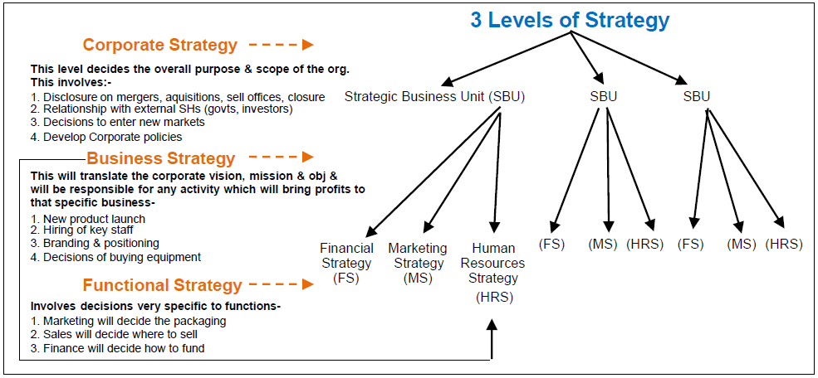
Levels of Strategy

Slide 46
Corporate Strategy – Looks at the industries in which the organisation operates. This may mean deciding to leave existing area or enter new ones. This is particularly true if the organisation has a number of divisions
Business Strategy – looks at how the organisation (or subsidiary/division) competes. This tends to mean either:
The division is trying to win customers by being better than rivals in some way (differentiation/focus as strategy)
OR,
The subsidiary is trying to win customers by being cheaper than rivals (cost leadership).
3. Operational Strategy – looks at how resources are used to carry out the strategies noted above
3 Levels of Strategy – Johnson & Scholes

Slide 47
What is Strategy?
Strategy can be defined as:
‘the direction and scope of an organisation over the long term, which achieves advantage in a changing environment through its configuration of resources and competencies with the aim of fulfilling stakeholder expectation
Simply put, strategy is how an organisation attempts to meet its objectives

Slide 48
Two Approaches to Strategy
1. Strategic Planning – involves formal analysis of each of the stages in strategic position before a final strategic option is chosen
Used in public sector, justify actions, considers all aspects of biz, proactivity
2. Free-wheeling opportunism – means having no long term strategic plan, in effect, making up the strategy as the organisation goes along
Quick response, etc.

Slide 49
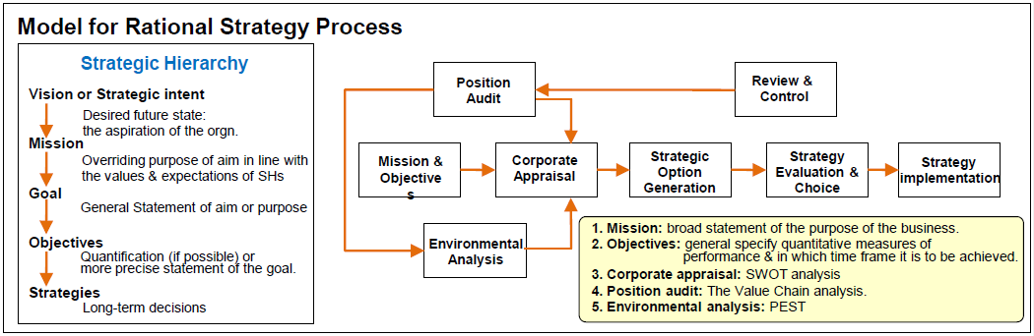
Old School Approach to Strategy?

Slide 50
More Approaches to Strategy?
Position-based strategy – organization that is responding to changes in the external environment (reacting to or anticipating opportunties and threats)
Resource-based strategy – organisation that concentrates on gaining an advantage because of its own strengths. These resources must be:
(1) valuable, (2) rare, (3) imperfectly imitable (tough to imitate), and (4) non-substitutable.

Slide 51
Three Lenses Approach to Developing Strategy?
Strategy as design – driven from the top
Strategy as experience – repeating what worked in the past
Strategy as ideas – encourage innovation

Slide 52

Next Module: 29.03.19 IS & Enterprise Strategy -IT Strategy & Competitiveness -Business Operating Models -Case Study

